Slide 1

Navigating Airplane safety perception
Insights and Recommendations for Executive Review

Slide 2

Introduction
Due to recent unfortunate airline crashes, the media has been promoting statistics stating air travel is no longer a safe way to travel. The public is bombarded with reports and figures about declining airline safety trends, challenging the notion of air travel as the safest mode of transportation.
News outlets emphasize negative statistics and sensationalize incidents, fostering fear and uncertainty among travelers.
What was once considered the safest mode of travel is now portrayed as one of the most dangerous, leading to skepticism and apprehension among the public.
In response to these challenges, our airline is taking a data-driven approach to analyze and address safety concerns. As part of the data science team, I am tasked with leveraging data and analytics to combat negative publicity and present the airline's side of the story with clarity and credibility.
This Photo by Unknown Author is licensed under CC BY-NC

Slide 3
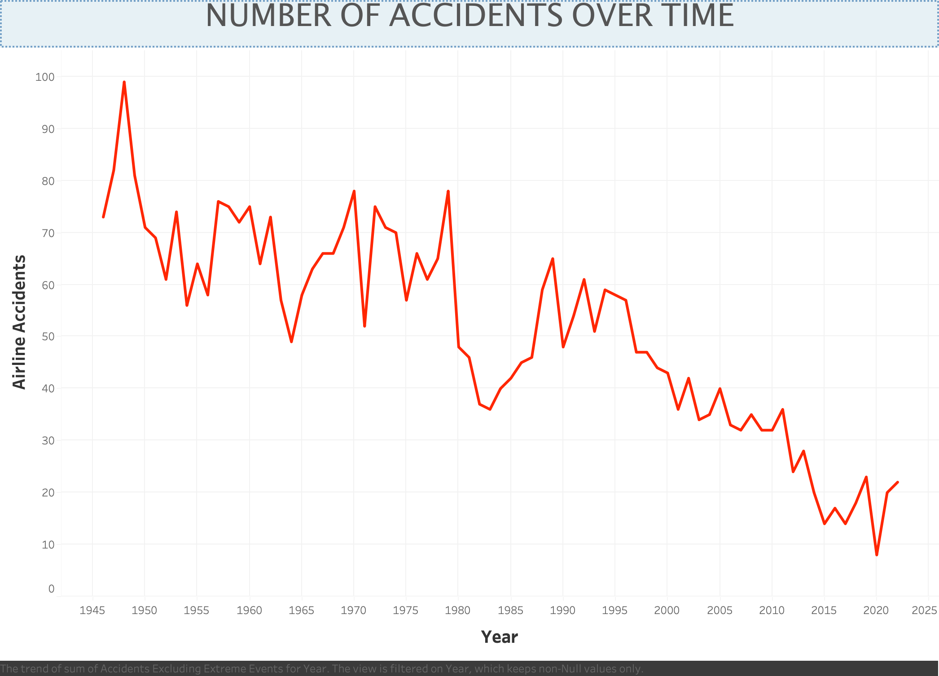
Trend Analysis
Initial Fluctuation: There was significant variability in the number of accidents from 1945 to the late 1970s, with peaks and valleys throughout.
Downward Trend: From the 1980s onwards, there's a clear and steady decline in the number of accidents
KEY TAKEAWAY: The overall downward trend in airplane accidents over the decades reflects the effectiveness of enhanced safety regulations and technological advancements in aviation.
Notes:
Airline Safety Dataset

Slide 4
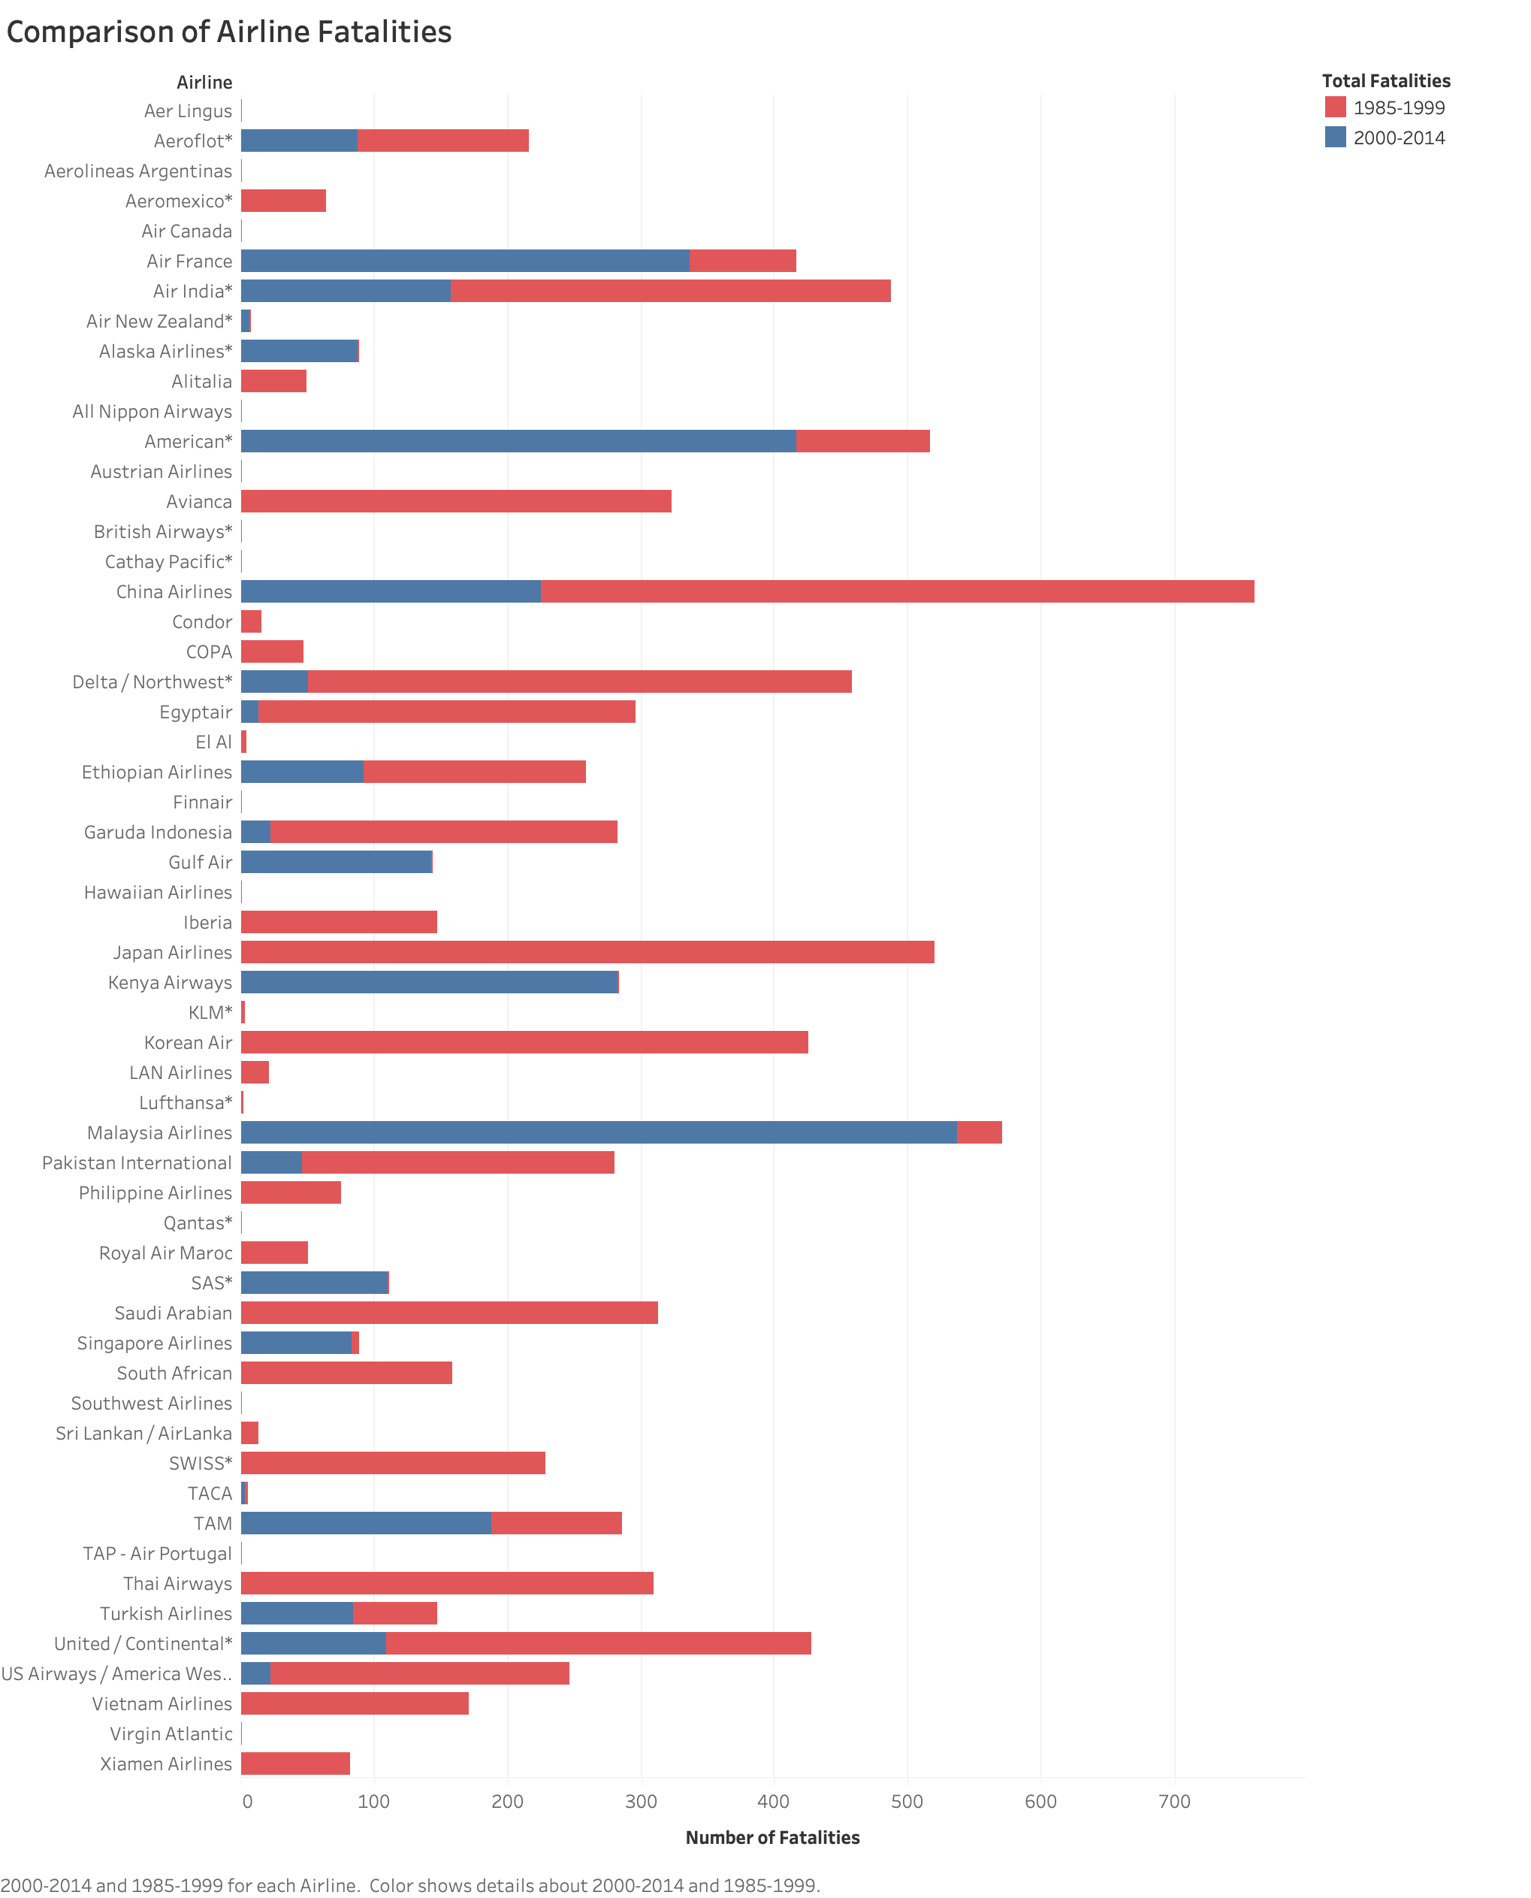
Airline Safety Records
The bar graph illustrates airline safety records, comparing total fatalities across different airlines during two periods: 1985-1999 and 2000-2014.
Balanced Perspective: Despite recent media focus, data shows long-term improvements in airline safety.
Safety Progression: The chart illustrates a decline in fatalities over time, highlighting advancements in safety protocols.
Benchmarking Excellence: Our airline's safety record is on par with, or exceeds, industry averages, demonstrating our commitment to passenger safety.
Transparency Builds Trust: Sharing comprehensive safety data reaffirms our transparency and builds customer trust.
KEY TAKEAWAY: Our airline maintains a strong safety record compared to industry standards.
Notes:
Clean Airline Safety Dataset

Slide 5
Comparing aircraft safety incidents across time
TYPE OF EVENT | 1985-1999 | 200-2014 | VARIATION DIFFERENCES (%)
Fatal Accidents | 122 | 37 | -69.67
Fatalities | 6295 | 3109 | -50.61
Incidents | 402 | 231 | -42.54
Drastic reduction in fatalities
Significant decrease in incidents
Highlighting enhanced safety measures and protocols
Effectiveness of ongoing improvements in aviation technology and procedures
KEY TAKEAWAY: The marked decrease in accidents and incidents signifies a significant enhancement in airline safety, countering perceptions of a decline in air travel safety.
Notes:
Airline Accidents = Cleaned Accidents

Slide 6
Transportation Fatalities by Mode
KEY TAKEAWAY:
Highways account for most transportation-related fatalities, consistently comprising over 94 percent of all fatalities each year!
Preliminary and Revised Data: The chart includes preliminary data for 2022 (labeled "P") and revised data for previous years (labeled "R"), indicating updates or estimates that may be subject to change.
Highway Dominance in Fatalities: Highway travel consistently accounts for the highest number of fatalities compared to air, railroad, and transit, year over year.
Remarkable Safety of Air Travel: The data illustrates the exceptional safety of air travel, with fatalities barely visible on the chart compared to other transportation modes.
Source Credit: Bureau of Transportation Statistics
Notes:
Source: https://www.bts.gov/content/transportation-fatalities-mode

Slide 7
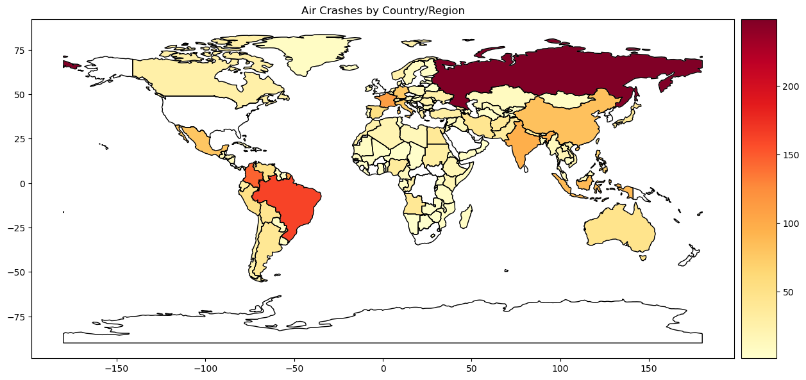
Mapping Air Crash Incidences
High-Incidence Regions: The map indicates that certain regions, such as parts of South America, Africa, and particularly Russia, exhibit a higher number of air crashes, with these areas highlighted in darker shades.
Safety in Developed Nations: Developed regions such as North America, Europe, and Australia demonstrate fewer air crashes, potentially reflecting more advanced aviation safety measures.
Implications for Safety Measures: The visual disparity in crash occurrences suggests a critical need for enhancing aviation safety protocols, particularly in high-incidence regions.
Key Takeaway: Targeted Safety Enhancements pinpoint areas for the aviation industry to improve safety through focused measures in training, infrastructure, and technology.
Notes:
Comprehensive Dataset Utilization: This dataset was sourced from the online database for air crashes (https://www.planecrashinfo.com). A valuable educational resource, it has been instrumental in teaching students about data analysis and visualization in Power BI and Python.

Slide 8
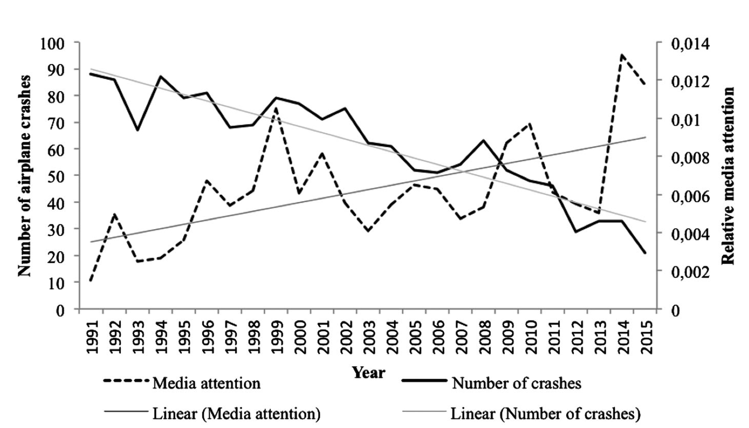
Public Perception
Media Attention vs. Aviation Incidents Over Time
Increasing Media Focus: Despite a decrease in actual aviation incidents, media attention has consistently risen from 1991 to 2015.
Contrasting Trends: Linear trends reveal an inverse relationship: as real-world aviation incidents decline, media coverage intensifies
Public Perception vs. Reality: The data suggests that media narratives may not align with the actual frequency of aviation incidents, potentially shaping public perception.
KEY TAKEAWAY: Media disproportionality highlights the disparity between media representation and actual trends, emphasizing the tendency for negative events to receive disproportionate coverage.
Source Credit: Toni G. L. A. van der Meer et al., Journalism Studies (2019)
Source Credit: Toni G. L. A. van der Meer et al., Journalism Studies (2019)
Notes:
Source Citation:
van der Meer, T. G. L. A., Kroon, A. C., Verhoeven, P., & Jonkman, J. (2019). Mediatization and the Disproportionate Attention to Negative News. Journalism Studies, 20(6), 783-803. DOI: 10.1080/1461670X.2018.1423632. Published online: 16 Jan 2018. © 2018 The Author(s). Published by Informa UK Limited, trading as Taylor & Francis Group.

Slide 9
Recommendations
Continue Enhancing Safety: Reinforce the trend of decreasing aviation incidents by continuing to invest in safety measures, technology, and infrastructure.
Strategic Communication: Address the disproportionality in media coverage by engaging in proactive and strategic communication, particularly in high-incident regions.
Data Transparency: Maintain transparency with the public by regularly sharing comprehensive safety data and analyses to build trust.

Slide 10
Conclusion
Summary: Reiterate the key finding that safety in air travel has significantly improved over time despite the rising media attention on negative incidents.
Call to Action: Urge executive leadership to commit to ongoing safety enhancements and ethical communication, bolstering the airline's reputation as a safety-conscious and trustworthy operator.

Slide 11
Works Cited
Bureau of Transportation Statistics. (2022). Transportation Fatalities by Mode. Transportation Fatalities Mode
FiveThirtyEight. (2022, December 16). Airline Safety. GitHub. Airline Safety
Ogwumike, J. (2023, September 17). Air Crashes Full Data 1908 -2023. Kaggle. Air Crashes Full Data 1908-2023
Ranter, H. (Ed.). (2021, November 20). Accidents and fatalities per year. Google Sheets. Accidents and Fatalities Per Year
van der Meer, T. G., Kroon, A. C., Verhoeven, P., & Jonkman, J. (2018). Mediatization and The Disproportionate Attention to Negative News. Journalism Studies, 20(6), 783–803. https://doi.org/10.1080/1461670x.2018.1423632 Mediatization and the Disproportionate Attention to Negative News

